Slide 1

Reliability engineering

Slide 2
Definitions
 Reliability - The ability of an item to perform a required function under stated conditions for a stated period of time. It is usually denoted as probability or as a success .
 Failure – The termination of ability of an item to perform a required function.

Slide 3

 Observed Failure Rate – For a stated period in life of an item, the ratio of the total number of failures in a sample to the cumulative of the time on that sample. The observed failure rate is associated with particular and stated time intervals(or summation of intervals) in the life of the item and under stated conditions.
 Observed Mean Time Between Failures(MTBF) – For a stated period in the life of an item, the mean value of the length of time between consecutive failures computed as the ratio of the cumulative observed time to the number failures under stated conditions.

Slide 4
 Observed mean time to failure (MTTF)-
For a stated period in the life of an item, the ratio of the cumulative time for a sample to the total number of failure in the sample during the period under stated condition

Slide 5
Name
Definition
Guarantee
An assurance given by the manufacturer to the vendor that the product will
work without failure for a stated period of time
Warranty
A written guarantee given to the purchaser of a new appliance,
automobile, or other item by the manufacturer or dealer, usually specifying that the manufacturer will make any repairs or replace defective parts free of charge for a stated period of time.
Maintainability
The measure of the ability of an item to be retained in or retained in or restored to a specified condition when maintenance is performed by personnel having specified skill levels, using prescribed procedures and
resources
Applies to a major tasks where many repetitions are expected and where considerable time is required
Availability
A tool for measuring the percent of time an item or system is in a state of readiness where it is operable and can be committed to use when called upon. Availability
ceases because of a downing event that causes the item/to system become unavailable to initiate a mission when called upon
Availability=MTBF/(MTBF+MTTR)
Reliability
The ability of an item to perform a required function under stated
conditions for a stated period of time. It is usually denoted as probability or as a success .

Slide 6
Guarantee
Warranty
Maintainability
Availability
Reliability
An assurance given by the manufacturer to the vendor that the product will work without failure for a stated period of time
A written guarantee given to the purchaser of a new appliance, automobile, or other item by the manufacturer or dealer, usually specifying that the manufacturer will make any repairs or replace defective parts free of charge for a stated period of time.
The measure of the
A tool for
The ability of an
ability of an item to be retained in or retained in or restored to a specified condition when maintenance is performed by personnel having specified skill levels, using prescribed procedures and resources
Applies to a major tasks where many repetitions are expected and where considerable time is required
measuring the percent of time an item or system is in a state of readiness where it is operable and can be committed to use when called upon.
Availability ceases because of a downing event that causes the item to become unavailable to initiate a mission when called upon
item to perform
a required
function under
stated
conditions for a stated period
of time. It is usually
denoted as
probability or as a success .
Availability=MT BF/(MTBF+MTTR)

Slide 7
Why engineering items failed?
 The design might be inherently incapable, the more complex the design ,more the difficult to overcome the problem
 The item might be overstressed in some way
 Failures can be caused by wear out.
Sufficiently strong at the start of the life and become weaker with age
 Failures can be caused by other time dependent mechanism such as battery run down, creep in turbine caused simultaneously by high temperature and tensile stress

Slide 8
 Failures can be caused by sneaks . Sneak is the condition in which the system does not work properly even though every part does
 Failures can be caused by errors such as incorrect specification, design ,fault assembly or test
 There are many other potential causes to failure such as oil leaks noisy ,display flickering etc.
 Knowing ,as far as is practicable, the potential causes of failures is fundamental to preventing them
 Failures might be caused by variation

Slide 9
What is reliability engineering
 Manufacturers often suffer high costs of failure under warranty
 Reliability is usually concerned with failures in the time domain. This distinction marks the difference between traditional quality control and reliability engineering
 Whether failures occur or not and their times to occurrence can seldom be forecast accurately
.reliability is therefore an aspect of engineering uncertainty
 Whether an item will work for a particular period is a
question which can be answered as a probability.
 Ultimately reliability engineering is effective management of engineering

Slide 10
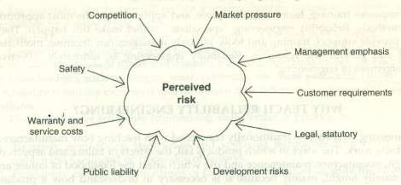
Need for Reliability

Slide 11
Non-Repairable items
 Reliability is the survival probability over the items expected life ,or for a period during its life, when only one failure can occur
 The instantaneous probability of the first and only failure is called hazard rate
 MTTF , the expected life by which a certain percentage might have failed is used here.
 The non repairable parts may be individual parts such as bulb, transistor or systems comprised of many parts such as spacecraft, microprocessor
 When a part fails in a non repairable system, the system fails, hence the reliability is function of the time to the first part failure

Slide 12
Repairable items
 Reliability is the probability that the failure will not occur in the period of interest, when more than one failure can occur .
 It can also be expressed as failure rate or the rate of occurrence of failures
 Reliability is characterized by MTBF, but only under the particular condition of a constant failure rate
 In a repairable system which contains which contains a part type ,the part will contribute by that amount to the system failure rate

Slide 13
Bath tub curve
 What: the concept is derived from the human life experience involving infant mortality, chances of failures, plus a wear out period of life since data for births and deaths is accumulated by government agencies. Most equipment lacks the birth/death recording by govt. and most non-human systems can be regenerated to live/die many times before relegation to the scrap heap

Slide 14
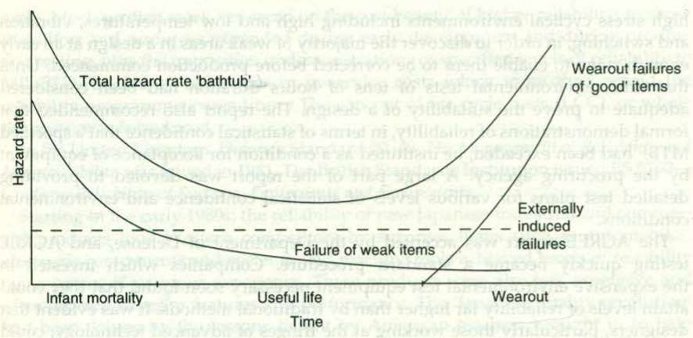
Bath Tub Curve

Slide 15
 Why: failures rate are different for both people and equipment at different phase of operation and the medicine to be applied to both humans and equipment need to be considered for effectively treating the roots of the problem

Slide 16
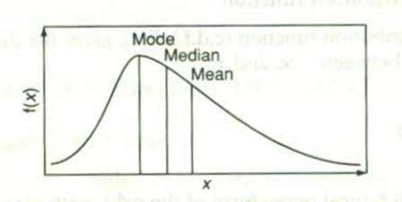
Mean | Median | Mode
The sample mean can be used to estimate the population mean , which is the average of all possible outcomes | It is the measure of the central tendency, which is the mid point of the distribution It is the point at which half the measured values fall to either side | It is the value at which the distribution peaks.

Slide 17
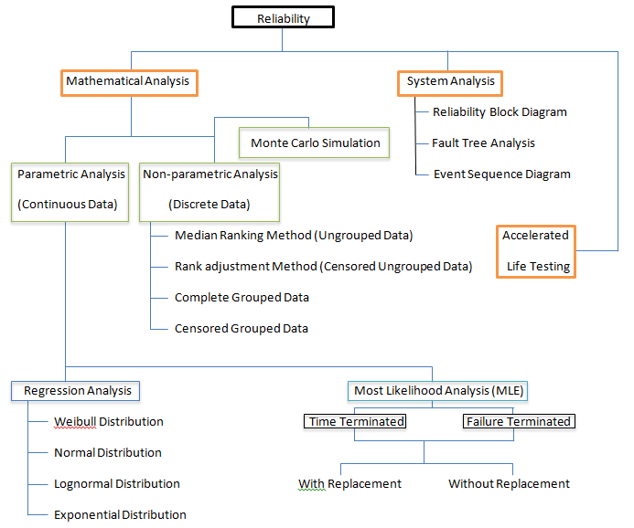

Slide 18
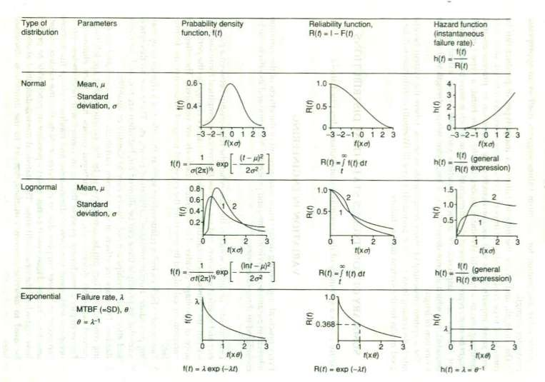
Distribution Plots

Slide 19
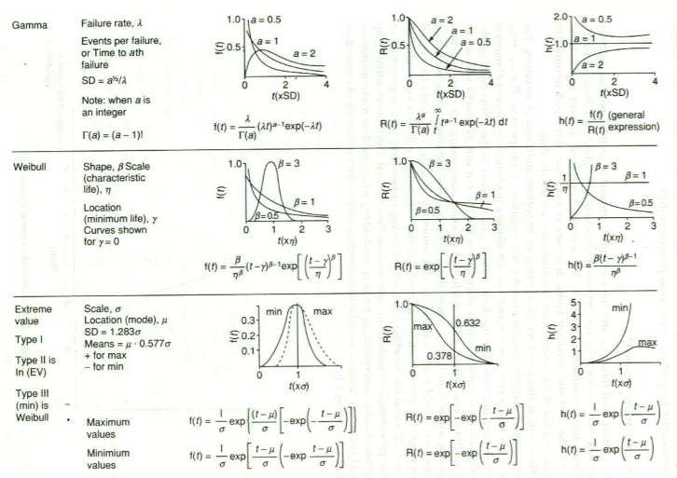

Slide 20
Parametric Analysis
 Parametric Analysis is fitting the data to a known distribution and estimating the parameters of the distribution.
 Parametric Analysis is done by using two most commonly used methods :
-Regression Analysis
-Most Likelihood Method
 Having got a fit, a statistic is calculated to estimate the goodness of the fit after which a confidence interval of the parameters can be found.

Slide 21
Regression Analysis
 Most commonly used continuous distribution are
Weibull Distribution
Normal Distribution
Lognormal Distribution
Exponential Distribution
 First we linearize the basic CDF by making the required transformation. From that we find parameters of the distribution.

Slide 22
Linearized Formulae for Weibull Distribution
 Xi=ln(ti)
 Yi=ln ln[1/( 1-F(ti) )]
where F(ti) is Cumulative Failure Function
 F(ti)= (i-0.3)/(n+4)
(For ith failure out of n components)
 β= Slope
 η = exp(-abs[intercept]/ β)

Slide 23
 A straight line is fitted using the X and Y data points by minimizing the sum of squares of the distance of the data points from the fitted line. The distance can be in vertical or horizontal direction.
 There is a correlation coefficient, referred to as r whose values varies from -1 to 1. The more the value of r^2 reaches 1 the more linear is the relation between X and Y.

Slide 24
Most Likelihood Method(MLE)
 It also helps in estimating the parameters of distribution.
 It does that by defining a likelihood function which is function of parameters of the distribution.
 The Likelihood function is maximized to find the parameters of the distribution.

Slide 25





Life Testing Data Types Used for MLE Estimates
With Replacement
TYPE I
Time Terminated
Without Replacement
Life Testing
With
TYPE II
Failure Terminated
Replacement
Without Replacement

Slide 26
MLE Weibull Parameter Estimation
r
β β
∑ t i ln t + ( n − r )t ln t
∑ ln t = 0
i =1
i s s
1 1
β r
r
g ( β ) =
i =1 ₋
∑ t + ( n − r )t
i =1
i
r
β β
i
s
r
_{β} ⎤ ⎫
1 / β
⎧ 1 ⎡
η = ⎨
⎢∑ ^{t}i
β
( n − r )t _{s}
⎥ ⎬
⎩ ^{r} ⎣ i =1
⎦ ⎭

Slide 27
 ts = 1
=Test time
= tr
For Complete Data For TYPE I Data
For TYPE II Data
 ti is time taken for ith failure
 r is the number of failures
 n is total number of components
 Find β for g(β)=0
 Substitute that in second equation and find η

Slide 28
Goodness Of Fit (GOF)
 r^2 value in the case of Regression analysis is used to find goodness of fit.
 For MLE we use the following GOF statistic.
Chi-Square Method
Kolmogorov-Smirnov Test
 Often data would fit many distribution.
Hence we have to find GOF so as to find the perfect distribution.

Slide 29
Chi Square Test
 Applicable to all distributions having large sample size.
 Applied to both discrete and continuous data.
 The probabilities are based on null hypothesis

Slide 30
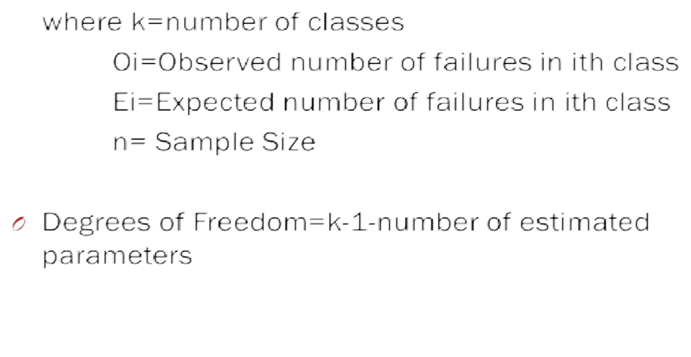
Formula Used


Slide 31
Example
There are 35 failure times listed below. Check if the distribution follows exponential distribution.
GIVEN DATA
1476 | 300 | 98 | 221 | 157
182 | 499 | 552 | 1563 | 36
246 | 442 | 20 | 796 | 31
47 | 438 | 400 | 279 | 247
210 | 284 | 553 | 767 | 1297
214 | 428 | 597 | 2025 | 185
467 | 401 | 210 | 289 | 1024

Slide 32
Group the result in specific bounds
Upper Bound | Number of failure times observed in that bound
350 | 18
750 | 10
2026 | 7

Slide 33
 Cumulative Failure Function, F(ti)=1- exp(-λti)
for exponential distribution.
Thus expected number of failures in the bound is given by
E(ti)=number of components*expected failure(F(ti))
Let λ=0.00206
E1=35*(1-exp(-350*0.00206))=17.98 E2=35*(1-exp(-350*0.00206)-P1)=9.55 E3=35*(1-P2-P1)=7.47

Slide 34
 From the formula, we find the value of χ^2
 Degree of Freedoms, k=3-1-1=1
 From the Statistic table for Chi-Square we get, for k=1 and χ^2=0.0496, α is between 10% to 20% (α should be less than 90%). Hence, the Null Hypothesis is accepted. Thus, we can say that the distribution is Exponential.

Slide 35
Kolmogorov-Smirnov Test
 It is also used to find the GOF but that it can be used even to small sample size.
 Formulae Used Sn(tn)=0
=i/n
=1
For -∞<t1
For ti<t< ∞;i=1,2….n-1
For tn<t<∞

Slide 36
K – S = max(|F(ti)-Sn(ti)|,|F(ti)-Sn(ti-1)|)
Where
F(ti) is Cumulative failure of the distribution
ti is the Time taken for ith Failure
n is sample size

Slide 37
Example
 The following 14 observations are on the failure time of a component in hours. Test the hypothesis that the failure time is normal.
For normal distribution, z= (x-μ)/σ
where μ is the mean
σ is the standard deviation
Cumulative Failure Function, F(ti)=(1/σ √2)℮^(-0.5)[(x- μ)/σ]^2

Slide 38
GIVEN DATA
i | TTF | i | TTF
1 | 61.6 | 8 | 72.7
2 | 63.4 | 9 | 73
3 | 65.1 | 10 | 75.3
4 | 65.5 | 11 | 77.1
5 | 70 | 12 | 78.4
6 | 72.3 | 13 | 83.2
7 | 72.5 | 14 | 83.5

Slide 39
Reliability Block Diagram
 Systems are composed of components
 RBD is a method of evaluating the reliability of the system by the establishing following relationship
 Series
 Parallel
 Combination of both
 These structure helps in understanding logic relationship

Slide 40


Series configuration
1
2
n
 Failure of any one component in the block will lead to the failure of the entire system
 Rs - system reliability
 E1 - event where component 1 does not fail
 E2 - event where component 2 does not fail
 R1 - reliability of component 1
 R2 – reliability of component 2

Slide 41
Formula
Rs = P(E1 E2 )
= P(E1) P(E2)
= R1 (R2 )
Therefore the system reliability must be greater than the individual component reliability
i.e. All component's must have high reliability in this configuration

Slide 42
Parallel configuration
 In a parallel system all elements must fail
for the system to fail
1
2
n

Slide 43
formula
RS=1-(1-R1)(1-R2)
Generalizing
Rs=1- [1- Ri (t) ]

Slide 44
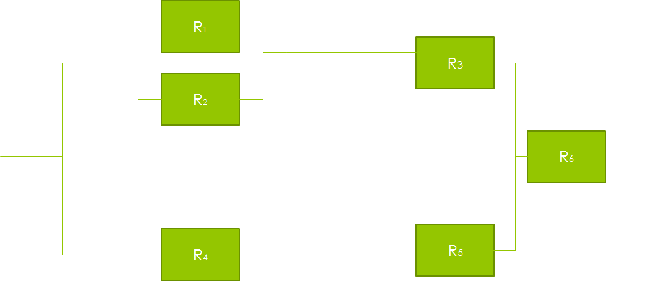
Combination of parallel and series

Slide 45
Example
 If R1=R2 =0.90,R3=R6=0.98,R4=R5=0.99
considering as constant failure rate
Solution:
Ra=1-(0.10)^2
Rb=[1-(0.10)^2](0.98)
=0.9702
Rc=(0.99)^2
=0.9801
& Rs=[1-(1-0.9702)(1-0.98)](0.98)
=0.9794

Slide 46
FAULT TREE ANALYSIS
 An undesired event is defined
 The event is resolved into its immediate
causes
 This resolution of events continues until basic causes are identified
 A logical diagram called a fault tree is constructed showing the logical event relationships

Slide 47
ELEMENTS
 FTA is a deductive analysis approach for resolving an undesired event into its causes
 FTA is a backward looking analysis, looking backward at the causes of a given event
 Specific stepwise logic is used in the process
 Specific logic symbols are used to to illustrate the event relationships
 A logic diagram is constructed showing the event relationships.

Slide 48
USES
 FTA is used to resolve the causes of system failure
 FTA is used to quantify system failure
probability
 FTA is used to evaluate potential upgrades to a system
 FTA is used to optimize resources in assuring
system safety
 FTA is used to resolve causes of an incident
 FTA is used to model system failures in risk assessments

Slide 49
FOUR STEPS
Define the undesired event to be analyzed (the focus of the FTA)
Define the boundary of the system (the scope of the FTA)
Define the basic causal events to be considered (the resolution of the FTA)
Define the initial state of the system

Slide 50
Highly Accelerated Stress Screening (HASS)
 Used to monitor the production process.
 All products are subjected to the same stresses during HALT but, at a lower level.
 It identifies process related defects.

Slide 51
Quantitative Accelerated Testing
 Planned/Controlled accelerated testing from which TTF under normal usage conditions can be derived.
 Models to be used for a specific agent of failure have been postulated.
 Accelerated Factor(AF)=TTFnormal/TTFstress
 AF is used to derive the normal TTF from accelerated TTF.
 Quantitative ALT helps predict the life of the product.

Slide 52
Improving the process
 Continuous improvement nearly always leads to reduced costs , higher producitvity,and higher reliability
 Methods that are available for process development are as follows
Simple charts
Control charts
Multi-vari charts
Statistical methods
Quality circles
Zero defects

Slide 53
Simple charts
 A variety of simple charting techniques can be used to help to identify and solve process variability problems.
 the pareto chart is often is used as starting point to identify most important problems and most likely causes.
 Measles chart is used when problems are distributed over an area
 The cause and effect diagram also called fishbone or ishikawa diagram can be used to structure and record problem solving and process improvement efforts. The main problem is indicated on the horizontal line and possible causes are shown as branches which inturn can have subcases

Slide 54
Control charts
While using control charts it is monitored continually to find trends that might indicate special causes of variation .trends can be continually run high or low or it can be a cyclic pattern. A continuous high or low trend indicates a need for process or measurement adjustment. A cyclic trend might be caused by temperature fluctuation, process drifts between settings change of materials etc…

Slide 55
Multi-vari charts
 A multi-vari chart is a graphical method for identifying the major causes of variation in a process. Multi vari charts can be used for process development and for problem solving, and they can be very effective in reducing the number of variables to include in a statistical experiment.

Slide 56
Multi-vari charts show whether the major causes of variation are spatial, cyclic or temporal. A parameter being monitored is measured in different position s at different points in the production cycle at different times. The results are plotted against two measurement locations, e.g. diameter at each end of the shaft, plotted against batch number from setup. It shows that batch to batch variation is the most significant cause, with a significant pattern of end to end variation(taper).

Slide 57
Statistical Methods
This method for analysis of variation can be used effectively for variation reduction in production process. They should be used for process improvement, in the same way as for product and process initial design. If a particular process has been the subject of such experiments during development, then the results can be used to guide studies for further experiments.
It is also used to identify the major causes of variation, prior to setting up statistical experiments. This way the number of variables to be investigated can be reduced leading to cost savings .

Slide 58
Quality Circles
It is the most widely used method world wide. A quality circle team consisting of operators is formed. This manage themselves, select leaders and members, and address the problems. They also suggest improvement if it under their control or they recommend it to the management.
The quality circle are taught to use analytical techniques to help identify problems and generate solutions. These are called the seven tools of quality.

Slide 59
The Seven tools of quality are
Brainstorm, to identify and prioritize problems
Data collection
Data analysis methods, including measles chart, trend charts and regression analysis
Pareto chart
Histogram
Cause and Effect diagram
Statistical Process Control(SPC) chart

Slide 60
Failure Reporting Analysis and Corrective Action System(FRACAS)
 Failure reporting and analysis is an important part of the QA function. The system must provide for
Reporting of all production test and inspection failures with sufficient detail to enable investigation and corrective action to be taken
Reporting the results of investigation and
action
Analysis of failures pattern and trends, and reporting on these
Continuos improvement by removal of causes

Slide 61
 The data system must be computerized for economy and accuracy modern ATE sometimes includes direct test data recordings and inputting to the central system by networking the data analysis must provide pareto analysis , probability plots and trend analysis for management
 Production defect data reporting and analysis must be very quick to be effective. Trends should be analyzed daily , or weekly atmost, particularly for high rates of production , to enable timely corrective action to be taken . The data analysis system also necessary for indicating areas for priority action, using the pareto principle of concentrating action on the few problem area that contribute to the most to the quality cost . For this purpose longer term analysis is necessary

Slide 62
 Defective component should not be scrapped immediately, but should be labeled and stored for the period , say one or two months , so that they are available for more detail investigation if necessary.
 Production defect data should not be analyzed in isolation by people whose task is primarily the data management. the people involved must participate to ensure that the data interpreted by those involved and that practical results are derived . the quality circle approach provides very effectively for this

Slide 63
 Production defect data are important for highlighting possible in service reliability problems. Many in-service failure modes manifest themselves during production inspection and testing. For ex, if a component or process generates failure on the final functional test, and these are connected before delivery , it is possible that the failure mechanism exist in product which pass test and are shipped . Metal surface protection and soldering processes present such risks .
Therefore production defects should always be analyzed to determine the likely effects on reliability , external failure cost and all internal production quality cost.

